Slide 1



Spring Security
December 2, 2019

Slide 2
Topics we covered
Architecture and key components of Spring Security
Spring Boot support for Spring Security
How to setup Basic, JDBC and Form Authentication

Slide 3
Why Spring Security?
Login and Logout functionality
Allow or Block access to URLs to logged in users
Allow or Block access to URLs to logged in users and with certain roles

Slide 4
What Spring Security can do?
Username/password authentication
SSO/LDAP/OAuth
App level authorization
Intra App Authorization like Oauth
Microservices Security (using tokens, JWT)

Slide 5
Key/Core Concepts of Spring Security
Authentication
Authorization
Principal
Granted Authority
Roles
Notes:
Authentication : Who is this user?
Authorization : Are they allowed to do this?
Principal : Is the person you identified through the process of authentication (currently logged in user)
Granted Authority : Authorization of permission is called as Authority or Granted Authority
Role : Group of authorities. Roles are fine grained permissions.

Slide 6
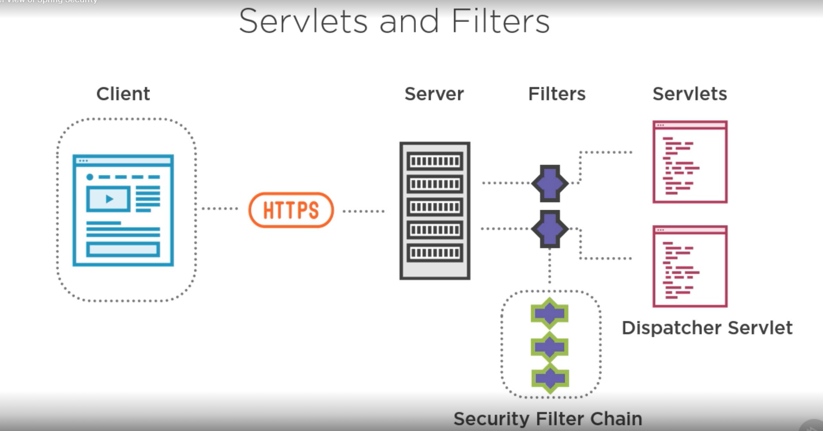
High Level View of Spring Security

Slide 7
Filter Interface
public interface Filter {
public default void init(FilterConfig filterConfig) throws ServletException {}
public void doFilter(ServletRequest request, ServletResponse response,
FilterChain chain) throws IOException, ServletException;
public default void destroy() {}
}
init : Called by the web container to indicate to a filter that it is being
placed into service.
doFilter : The doFilter method of the Filter is called by the container each time a request/response pair is passed through the chain due to a client request for a resource at the end of the chain. The FilterChain passed into this method allows the Filter to pass on the request and response to the next entity in the chain
destroy : Called by the web container to indicate to a filter that it is being taken out of service.

Slide 8
Request
Web Client
Servlet Container DelegatingFilterProxy
FilterChainProxy
Filter Chain
Looks up filter
web.xml
Configured
Dispatch Servlet
Controller

Slide 9
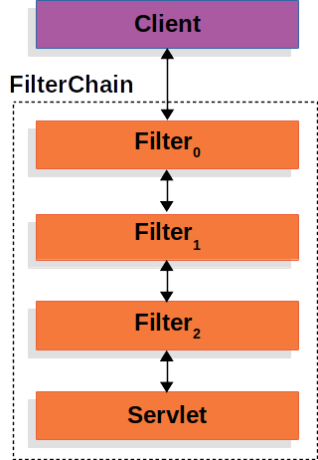
High Level View of Spring Security

Slide 10
Web.xml
<filter>
<filter-name>springsecurityFilterChain</filter-name>
<filter-class>org.springframework.web.filter.DelegatingFilterProxy</filter-class>
</filter>
<filter-mapping>
<filter-name>springsecurityFilterChain</filter-name>
<url-pattern>/*</url-pattern>
</filter-mapping>

Slide 11
Security Filter Chain Proxy

Slide 12
SecurityFilterChainProxy
/user
FilterChain Order 1
BasicAuthenticationFilter
Filter
Filter
/admin
FilterChain
Order 2
JDBCAuthenticationFilter
Filter
Filter

Slide 13
SecurityFilterChain Interface
public interface SecurityFilterChain {
List<javax.servlet.Filter> getFilters()
boolean matches(javax.servlet.http.HttpServletRequest request)

Slide 14
Filter Chain
ChannelProcessingFilter
SecurityContextPersistenceFilter
ConcurrentSessionFilter
AuthenticationFilters
SecurityContextHolder
Security Context
Authentication Principle
RememberMeAuthenticationFilter
RememberMeAuthenticationFilter
AnonymousAuthenticationFilter
ExceptionTranslationFilter
FilterSecurityInterceptor

Slide 15
SecurityContext
public interface SecurityContext extends Serializable {
void setAuthentication(Authentication authentication); Authentication getAuthentication();

Slide 16
Authentication

Slide 17
Authentication
Request
Authentication Filter
BasicAuthenticationFilter OpenIDAuthenticationFilter DigestAuthenticationFilter
UsernamePassword AuthenticationFilter
Create
<< Authentication >>
UsernamePasswordAuthenticationToken OpenIDAuthenticationToken
Authenticated
Authenticate
Authenticated
AuthenticationManager

Slide 18
Authentication
<< Authentication Provider >>
OpenIDAuthenticationProvider DaoAuthenticationProvider LdapAuthenticationProvider
Authenticate
AuthenticationManager
Authenticated

Slide 19
AuthenticationManager Interface
public interface AuthenticationManager {
Authentication authenticate(Authentication authentication) throws AuthenticationException;

Slide 20
Authentication Interface
import | java.security.Principal
public | interface Authentication | extends | Principal, | Serializable | {
Collection<? extends GrantedAuthority> getAuthorities();
Object getCredentials(); Object getPrincipal();

Slide 21
<< Authentication >>
Authentication request
Authenticated: False
Principle: Username
Credentials: Password
Authorities:
Authenticated principle
Authenticated: True
Principle: UserDetails
Credentials:
Authorities: Roles e.g. ADMIN

Slide 22
Authentication Provider
<< UserDetailsService >>
InMemoryUserDetailsManager JdbcUserDetailsManager LdapUserDetailsManager
loadUserByUsername
AuthenticationProvider
UserDetails

Slide 23
AuthenticationProvider Interface
public interface AuthenticationProvider {
Authentication authenticate(Authentication authentication) throws AuthenticationException;
boolean supports(Class<?> authentication);

Slide 24
UserDetailsService Interface
public interface UserDetailsService {
UserDetails loadUserByUsername(String username) throws UsernameNotFoundException;

Slide 25
Security Context Holder
SecurityContextHolder
SecurityContext
setAuthentication
Authentication
Security Filter

Slide 26
Recap
AuthenticationFilter
add
SecurityContextHolder
generates
Authenticated Request
Security Context
Authenticated Principle
Authentication Principle
authenticate
AuthenticationManager
delegates
get UserDetails
AuthenticationProviders
UserDetailsService

Slide 27
An Authentication Filter generates an Authentication Request and calls the Authentication Manager to authenticate
The Authentication Manager delegates authentication to the Authentication Provider(s)
The Authentication Provider requests the UserDetails from the UserDetailsService and adds it the Authentication
Then the Authentication Principle is added to the SecurityContext by the Authentication Filter
Summary

Slide 28



Spring Security with Spring Boot
Version management
Automatically configures security filter chain
Handles a lot of the unnecessary boilerplate code and configuration

Slide 29

Demo
Configuring Spring Security with Spring Boot
Default form login

Slide 30
Basic Authentication

Slide 31

Used with stateless clients
Not secure
Username / password transmitted in plain text
Spring implementation compatible with RFC 1945, Section 11
Credentials transmitted in the header
Header name: Authentication
Header value: Basic + Base64(username:password)
E.g. Authorization: Basic Ym9iOnBhc3N3b3Jk

Slide 32
Security Filters
ChannelProcssingFilter
SecurityContextPersistenceFilter
ConcurrentSessionFilter
BasicAuthenticationFilter
SecurityContextHolder
Security Context
Authentication
UsernamePasswordAuthenticationFilter
RememberMeAuthenticationFilter
RememberMeAuthenticationFilter
AnonymousAuthenticationFilter
ExceptionTranslationFilter

Slide 33
Demo
Configure Basic Authentication

Slide 34

Authentication
Filters
Authentication manager.
UserDetailsService / UserDetails
SecurityContext
Summary
Basic and JDBC Authentication
Spring Boot HSTS, HTTPS

Slide 35
References
https://spring.io/guides/topicals/spring-security-architecture
https://docs.spring.io/spring-security/site/docs/current/guides/html5/helloworld-boot.html
https://spring.io/guides/gs/securing-web/
https://docs.spring.io/spring-security/site/docs/current/reference/htmlsingle/

